Slide 1
Math 104: the dreaded word problems Section 6.6
Megan Gobeille
UAA

Slide 2
What do you know about word problems?

Slide 3
Example from 6.6: Yard dimensions
MATH A104
Megan Gobeille

Slide 4
Section 6.6: Yard dimensions
One side of a rectangular yard is bounded by the side of a house. The other three sides are to be fenced with 345 ft of fencing. The length of fence opposite the house is 15 ft less than either of the other two sides. Find the length and width of the yard.

Slide 5
Section 6.6: Yard dimensions
One side of a rectangular yard is bounded by the side of a house. The other three sides are to be fenced with 345 ft of fencing. The length of fence opposite the house is 15 ft less than either of the other two sides. Find the length and width of the yard.
What are we supposed to find?
What do we know?

Slide 6
Section 6.6: Yard dimensions
One side of a rectangular yard is bounded by the side of a house. The other three sides are to be fenced with 345 ft of fencing. The length of fence opposite the house is 15 ft less than either of the other two sides. Find the length and width of the yard.
Let’s draw a picture
Then translate from words or picture to math:

Slide 7

Section 6.6: Yard dimensions
One side of a rectangular yard is bounded by the side of a house. The other three sides are to be fenced with 345 ft of fencing. The length of fence opposite the house is 15 ft less than either of the other two sides. Find the length and width of the yard.
Translation: $x+\left(x−15\right)+x=345$
Solve:

Slide 8
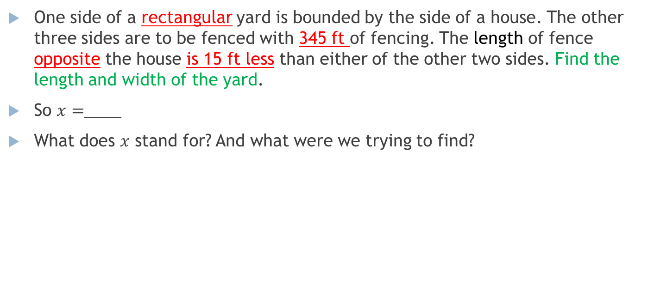
Section 6.6: Yard dimensions
One side of a rectangular yard is bounded by the side of a house. The other three sides are to be fenced with 345 ft of fencing. The length of fence opposite the house is 15 ft less than either of the other two sides. Find the length and width of the yard.
So $x=$____
What does $x$ stand for? And what were we trying to find?

